Slide 1


Analytics for financial services Group assignment Team Bnalytics for financial services gRoup assignment team b

Slide 2
1 – THE SEGMENT SELECTED

Slide 3
Our segmentur segment
What customer segment did you select?
The customer segment will be small businesses and start-ups as they are an important segment for the entrepreneurial landscape in which they can disrupt large enterprises.
Why?
Small Medium Enterprises (SMEs) have become a major contribution to the development of countries where 99 out of every 100 businesses are classified as SMEs, & 9 out of 10 SMEs are classified as micro-SMEs according to Eurostat & the Annual Report 18/19.
Taking care of these customers is a long-term strategy as some of these start-ups might end up being a big multinational companies with great revenues, hence a very profitable.

Slide 4
What sort of products would a customer of our segment usually hold?
Treasury management to get a holistic perspective of all business finances.
Business credit cards with competitive rates.
Money market account to access their money at any time.
No minimum balance requirements.
Give an holistic analysis of the segment

Slide 5
THIS IS HOW WE define the portfolios and THE sort of commercial role WE would BE assigning to THEM
Team B would implement a portfolio-oriented strategy that shall concentrate a relevant proportion of SMEs business volumes, have all data-sources in place when portfolios are designed and activate commercial roles by offering attractive and customized banking services.

Slide 6
HERE ARE other commercial initiatives THAT WE would put in place SO to grow the value of THIS customer segment
Offer customized current accounts
Payments gateways
Tie-ups with different service providers
Mentorship
Co-working space
Support from the bank’s business management team

Slide 7
2 – PROPOSED CRM TOOL

Slide 8












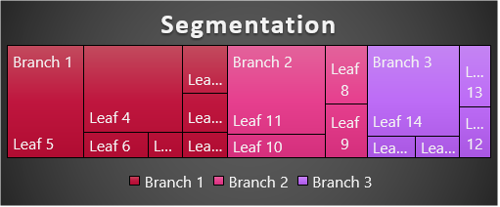
Search CRM Tool
Sales
Home
Accounts
Opportunities
Leads
Contacts
Reports
Dashboards
Accounts
Sales Team
Americas
APAC
LatAM
EMEA
Top Start-ups by Revenue
1- …
2- …
3- …
4- …
5- …
…
Key Performance Metrics
Show pipeline by value
Show pending quotes
Achievement VS Target
Executives
Nabil M.
Send a follow-up email
50%
Michael W.
30%
Addison P.
20%
Sarang Z.
Show individual sales performance
10%
9%
Refresh
Download report

Slide 9

Video Presentation
IE University GMBD 2020 – Team B Financial Analytics Videos (Click link)

Slide 10
The End

